Slide 1
Module 4: Prevention

Slide 2
Learning Objectives
Understand the main strategies for TB prevention
Understand the role of contact screening and management
Identify groups for which TB preventive treatment (TPT) is recommended
Choose appropriate TPT regimens as per new recommendations for contacts of people with drug-susceptible or drug-resistant TB.
Notes:
TB prevention consists of interventions to a) stop TB infection and b) reduce the progression of TB infection to active TB disease. The implementation of TB prevention interventions is a critical component of global efforts to reduce TB incidence to the levels envisioned by the WHO END TB Strategy.
In this module, you will understand the key strategies implemented at the health facility and in the community to prevent the spread and development of TB. These include vaccination, TB preventive treatment known as TPT and TB infection prevention and control in the healthcare setting and community.
You will understand how to systematically conduct contact screening and management as well as learn of the different considerations for provision of TPT for child contacts of both drug susceptible and drug resistant TB.

Slide 3
Outline
Introduction and strategies for TB prevention
BCG vaccination
Contact screening and management
Regimens for TB prevention – including regimens for prevention of MDR-TB
TB infection prevention and control in healthcare settings
Conclusion
Challenge your knowledge
Notes:
In this module, we will explore the three main strategies for TB prevention with special emphasis on provision of TB preventive therapy or TPT.
We will discuss the importance of BCG vaccination for preventing mortality from TB particularly in high TB burden countries.
We will then explore contact screening and its role in increasing the uptake of TB preventive therapy. In this section, we will discuss the different considerations ruling out active TB and initiating TPT among child contacts of patients diagnosed with TB.
We will discuss the TPT regimens for different groups of children and adolescents at high risk for developing TB, including child and adolescent contacts of patients with drug-resistant TB.
Finally, we will highlight the importance of TB infection prevention and control to reduce transmission risk especially in healthcare settings.
We’ll conclude the module with a summary of key points for you to take away.

Slide 4
Outline
Introduction and strategies for TB prevention
BCG vaccination
Contact screening and management
Regimens for TB prevention – including regimens for prevention of MDR-TB
TB infection prevention and control in healthcare settings
Conclusion
Challenge your knowledge
Discussion
Discussion
Notes:
There will also be a couple of opportunities to share some of your own country specific setting practices during small group discussions.

Slide 5
Discussion – setting specific practices
Note to facilitator:
Suggested instructions:
These context specific discussion opportunities will occur repeatedly throughout this training. Here are some suggestions on how you might like to facilitate them, to run them in a time efficient manner.
Explain that the next 15 minutes will be devoted to sharing amongst your colleagues, about how things may work in your setting.
Explain that 3, or 4, questions will be shown on the presentation.
Then divide the questions amongst the groups. Some groups may need to discuss the same question.
Tell them they will have just 2 or 3 minutes to discuss in their small groups. Then you will discuss as a large group.
Allow 2-3 minute discussion time.
When this time is up, ask for everyone’s attention. And then ask for volunteers to comment on each question discussed. Request participants to keep their responses succinct so that the time allows for others to also contribute.
Acknowledge all responses and thank participants for sharing.
Be mindful of the time and try to wrap up discussions so that the full activity takes no more than 15 minutes.
Click for audible instructions
To discuss Question 1
To discuss Question 4
To discuss Question 2
To discuss Question 3
Notes:
These context specific discussion opportunities will occur repeatedly throughout this training.
Here are some suggestions on how you might like to facilitate them, to run them in a time efficient manner.
Explain that the next 15 minutes will be devoted to sharing amongst your colleagues, about how things may work in your setting.
Explain that 3, or 4, questions will be shown on the presentation.
Then divide the questions amongst the groups. Some groups may need to discuss the same question.
Tell them they will have just 2 or 3 minutes to discuss in their small groups. Then you will discuss as a large group.
When this time is up, ask for everyone’s attention. And then ask for volunteers to comment on each question discussed. Request participants to keep their responses succinct so that the time allows for others to also contribute.
Acknowledge all responses and thank participants for sharing.
Be mindful of the time and try to wrap up discussions so that the full activity takes no more than 15 minutes.

Slide 6
Discussion: BCG vaccination, contact screening and management
What is the newborn BCG coverage in your setting and the challenges hindering access to BCG vaccination?
1
Do you routinely implement TB contact investigation in your setting?
– describe current approach to screening and eligibility for TPT .
2
What infection prevention and control measures are implemented in your healthcare facilities to protect children and healthcare workers from TB?
3

Slide 7
What is the newborn BCG coverage in your setting and the challenges hindering access to BCG vaccination?
1
Do you routinely implement TB contact investigation in your setting?
– describe current approach to screening and eligibility for TPT
2
What infection prevention and control measures are implemented in your healthcare facilities to protect children and healthcare workers from TB?
3

Slide 8
Introduction and strategies for TB prevention

Slide 9
Introduction
Recommended approaches for TB prevention include:
BCG vaccination.
Provision of TB Preventive Treatment (TPT) – also known as treatment of TB infection – for eligible contacts and PLHIV.
TB infection prevention and control in healthcare settings and in communities where people with TB live.
Notes:
The main strategy to successfully end TB and prevent new infections and new TB disease cases is to reduce transmission which requires finding and treating all the TB cases that are currently in the community. In this module, we will focus on specific strategies for TB prevention that include:
BCG vaccination which is widely recommended as part of several national childhood immunization programmes particularly in high TB burden countries.
The recommended use of TB preventive treatment or TPT to prevent progress from infection with MTB to active TB disease particularly among people at high risk of progression. These include recent TB contacts, especially young child contacts as well as people living with HIV.
The third one, TB or air-borne infection prevention and control or IPC for short, is also highly relevant for children and adolescents. In health care settings where people are often exposed to other people with TB that could be undiagnosed or untreated, efforts should be made to minimize the risk for TB transmission to healthcare workers, patients and their families. IPC plans should be developed based on a three-level hierarchy of control measures and include: administrative measures, environmental controls and use of protective wear.

Slide 10
BCG vaccination

Slide 11
Bacille Calmette-Guérin (BCG) vaccination
BCG is a live vaccine which stimulates the immune system so it is ‘prepared’ and can react when confronted with TB bacteria.
BCG protects infants and young children against severe forms of disseminated TB e.g., miliary TB or TB meningitis.
The protection provided by newborn BCG vaccination wanes over time.
BCG is a very safe vaccine with very few risks except for severely immunosuppressed infants.
Notes:
The BCG vaccine contains particles from Mycobacterium bovis from the same family as Mycobacterium tuberculosis, which have been modified (attenuated) so as not to cause disease. The BCG vaccine is safe for almost all newborns.
In TB endemic settings, newborns should routinely receive the BCG vaccination soon after birth; ideally before they are discharged from hospital. When given to newborns, BCG mainly protects infants and young children from severe forms of disseminated TB, such as TB meningitis or miliary TB. BCG may also prevent infection as well as disease. Protection wanes over time – limited effect after 5 years when given to newborns – and is less for pulmonary TB than for disseminated forms.
Newborns of mothers of unknown HIV status should receive BCG vaccination as the benefits outweigh the risks. Neonates of unknown HIV status born to HIV-infected mothers should be vaccinated if they have no clinical evidence suggestive of HIV infection, regardless of whether the mother is receiving ART
However, an infant or child with confirmed HIV infection who did not receive BCG at birth should not receive BCG until ART has been started and the infant is confirmed to be immunologically stable (CD4 >25%).

Slide 12
Contact screening and management

Slide 13
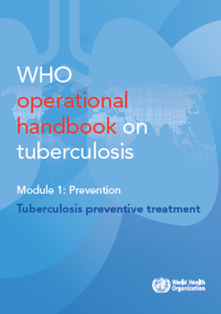
TB contact screening and management
Screening of close contacts of recently diagnosed TB patients is widely and strongly recommended.
To encourage a person-centered approach: contact screening may be carried out in the home by a lay healthcare worker.
Categories of TB patients prioritised for contact tracing include:
Bacteriologically confirmed pulmonary TB
Children with TB
PLHIV
People with RR/MDR-TB
WHO consolidated guidelines on tuberculosis. Module 1: prevention – tuberculosis preventive treatment. Geneva: World Health Organization; 2020. Licence: CC BY-NC-SA 3.0 IGO.
Notes:
Screening of close contacts of patients diagnosed with TB is strongly and widely recommended although poorly implemented in most high TB burden settings. Close contacts of index TB patients may be within the household or outside the household (e.g. school, workplace, neighbourhood).
Contact screening is important because it serves two main functions:
it enables the health system to identify and treat contacts that have undiagnosed TB disease and
It helps to identify and treat at-risk contacts that require TB preventive treatment.
Contact screening should be integrated into the approach for the treatment for TB disease. In most countries, contact screening is prioritized for patients with bacteriologically pulmonary TB, children, TB patients living with HIV and patients with MDR TB. Contact screening and management has a higher coverage by taking a decentralised, community-based approach compared to a passive, facility-based approach. Family-integrated and person-centred care can be provided in the home by a community healthcare worker who is trained and supported to screen and provide appropriate care for both contacts and index cases with TB.

Slide 14
Guidance for screening and management of contacts
ADULT & CHILD
ADAPT TO LOCAL SETTING
Document TB exposure, age and HIV status
*symptoms include: cough, fever, weight loss, lethargy, neck swelling
Any current symptoms* suggestive of TB?
No
Manage further according to age and HIV status:
Yes
5-19 years and HIV-uninfected
If available, do TST or IGRA:
< 5 years or HIV infected
TST or IGRA negative
TST or IGRA positive or not done
Start TPT.
Follow up. If TPT started, complete. Monitor for development of TB symptoms:
No TB symptoms develop.
TB symptoms develop
Refer to treatment module 3 for the approach to treatment decision.
Decision to start TB treatment
Decision to defer TB treatment: review in 2-4 weeks.
Discharge. If TPT started, complete.
Symptoms persist.
Symptoms resolve.
Start TB treatment: regular follow up. If poor response after 2 months, refer.
Reassess eligibility for TPT – start from top of the algorithm again.
Notes:
The approach to contact screening and management, including determining eligibility for TPT should follow national policy and guidelines. The flow chart shown here is an example from the Union Deskguide that is a decision approach to contact screening and management.
Contacts of all ages, including children and adolescents, of patients diagnosed with TB should be screened for TB symptoms. Any contact with symptoms should be carefully assessed for TB disease –using microbiological testing whenever possible- and promptly treated if TB is detected. Any child or adolescent contact who is asymptomatic or who had a positive symptom screen but had active TB disease ruled out on further evaluation (with sputum test and CXR) are eligible for TPT.
Young children or PLHIV who are negative on symptom screen are eligible to initiate TPT without further investigation.
To determine eligibility for TPT in HIV-uninfected contacts of 5 years and older, a positive test for infection with TST or IGRA is preferred along with a negative CXR screen or normal CXR to rule out active disease. However, if the test for infection is not available, then TPT can be initiated if CXR screen is negative. If CXR is not available, the absence of any symptoms is taken to indicate the absence of active TB disease. All contacts receiving TPT should be followed until completion – and this can often be integrated with the treatment support for the index case or any other household member receive g treatment for active disease.

Slide 15
Discussion on setting-specific practices

Slide 16
Discussion: TB Preventive Treatment
Which contacts are eligible to receive TB preventive treatment?
1
Are there situations where children and adolescents do NOT complete TPT and if so, how can this be addressed?
2
What is your current approach to the management children and adolescents exposed to RR/MDR-TB?
3

Slide 17
Which contacts are eligible to receive TB preventive treatment?
1
Are there situations where children and adolescents do NOT complete TPT and if so, how can this be addressed?
2
What is your current approach to the management children and adolescents exposed to RR/MDR-TB?
3

Slide 18
Considerations for contact investigation
Considerations for contact investigation
Contact with a person who has TB
Closeness of contact
Duration of contact
Sleeping in same room
Source case
Smear positivity
Bacteriologic confirmation
Cavities on CXR
Increased exposure
Living in high TB endemic communities
Living with HIV
Crowded, poorly ventilated environment
Notes:
Let’s briefly review the considerations for contact investigation, also known as contact screening and management. Listed here are features to consider that are known to risk of infection and can be documented. These include the characteristics of the index case which relate to their infectiousness such as being sputum positive or having cavities on CXR as well as the closeness of the contact such as sharing the same household or spending a lot of time in close contact during the day.

Slide 19
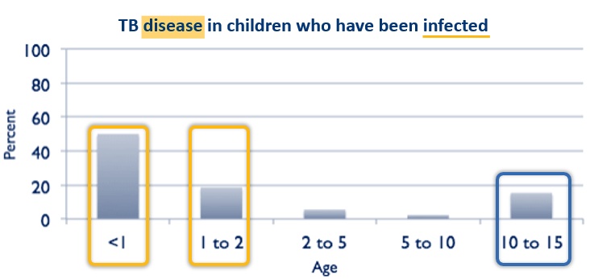
Consider risk of disease after infection
Consider risk of disease after infection
Child and adolescent contacts are at high risk of infection
Immunosuppressed
Age
Adapted from Marais BJ, et al. The natural history of childhood intra-thoracic tuberculosis: a critical review of literature from the pre-chemotherapy era. Int J Tuberc Lung Dis. 2004 Apr;8(4):392-402. PMID: 15141729
Notes:
It is also important to consider the risk of disease following exposure and infection.
TPT is prioritised for individuals at highest risk for progression to TB disease following recent exposure and infection. All child and adolescent contacts are at high risk of infection and the risk of disease relates to age or whether the contact may be immunosuppressed such as being malnourished or HIV-infected.
The risk is particularly high in young children which is why they are prioritised for screening for disease and to receive TPT if symptom screen is negative. The risk is lower in older children but increases again in adolescents. BCG reduces this risk in the first years of life, but only of severe disease. TPT greatly reduces risk of all TB by up to 90% across all ages if infected.
Follow national guidelines for evaluation of contacts to determine eligibility for TPT.

Slide 20
Regimens for TB prevention

Slide 21
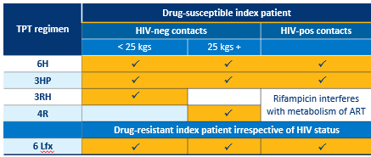
TPT options for child contacts
ADULT & CHILD
TPT options for child contacts
ADAPT TO LOCAL SETTING
TPT regimen | Drug-susceptible index patient
 | HIV-neg contacts |  | HIV-pos contacts
 | < 25 kgs | 25 kgs +
6H
3HP
3RH |  |  | Rifampicin interferes with metabolism of ARVs
4R
 | Drug-resistant index patient irrespective of HIV status
6 Lfx
 ✓
 ✓
 ✓
 ✓
 ✓
 ✓
 ✓
 ✓
 ✓
 ✓
 ✓
H – isoniazid | P –rifapentine | R – rifampicin | Lfx - levofloxacin
WHO consolidated guidelines on tuberculosis. Module 1: prevention – tuberculosis preventive treatment. Geneva: World Health Organization; 2020. License: CC BY-NC-SA 3.0 IGO
Available via: https://www.who.int/publications/i/item/9789240001503
Notes:
There are several regimens currently recommended for TPT. Follow national guidelines and note that choice of TPT option depends on a number of factors as seen in the Table.
Six months of daily isoniazid is an option that has long been used for child and adolescent contacts and especially so for those living with HIV and receiving ART.
A preferred option is now three months of weekly rifapentine and isoniazid combination. It is a shorter and safer regimen with improved adherence to completion. Furthermore, it has recently become more suitable and feasible for child contacts since new WHO guidelines in 2024 that rifapentine can be used in all ages. Unlike rifampicin, rifapentine can be used without changing dosage of ARTs and a child-friendly dispersible formulation of rifapentine has recently been developed.
Short and safe TPT options containing rifampicin are also recommended in HIV-negative contacts but not preferred in PLHIV as rifampicin interferes with the metabolism and drug levels of some of the ARVs. Compared to 6H, three months of daily rifampicin-isoniazid combination (3RH) or four months of daily rifampicin (4R) are associated with fewer severe adverse events and better adherence to completion. The choice is determined by suitability of formulation. Three months of daily isoniazid and rifampicin using the dispersible fixed dose combination is the preferred option for children of less than 25 kgs, which is usually up to about 10 years of age.. For contacts who are 25 kgs or more, usually adolescents or adults, 4 months of daily rifampicin using the 300 mg tablet is a more suitable option.
For contacts of patients with drug resistant TB which is fluoroquinolone-susceptible, six months of Levofloxacin is recommended once active disease in contacts has been ruled out. Strict clinical observation for signs of TB disease for at least two years after exposure should be ensured, regardless of whether TPT for MDR-TB is given or not.

Slide 22
Considerations for monitoring children and adolescents on TPT
Follow–up visits | Conduct regular follow–up visits as per national guidelines. Align follow-up visits for the index TB case and contacts on TPT to strengthen adherence, including PLHIV receiving ART.
Weight monitoring | Check weight on every follow–up visit and adjust dosages accordingly.
Adherence | Review adherence to TPT. Implement a family-centered approach to strengthen adherence.
TB symptoms | Assess for TB symptoms at each follow–up visit.
Side effects | Assess for side effects at each follow–up visit and manage as per the national guidelines.
Notes:
Children and adolescents generally tolerate TPT very well, especially young children, and serious adverse events are rare. However, regular follow-up is important to review side-effects, assess for TB disease, check weight, correct dosage and to strengthen adherence. Consider pyridoxine co-administration if TPT contains isoniazid, though the risk of isoniazid-related neuropathy is extremely low in child contacts who are otherwise well.
Although it is challenging to convince a family that their child needs to take medicine every day for months, when the child is well, it is especially important to make every effort to do this as the effectiveness of TPT is dependent upon completion of the full treatment course.

Slide 23
TB infection prevention and control in healthcare settings

Slide 24
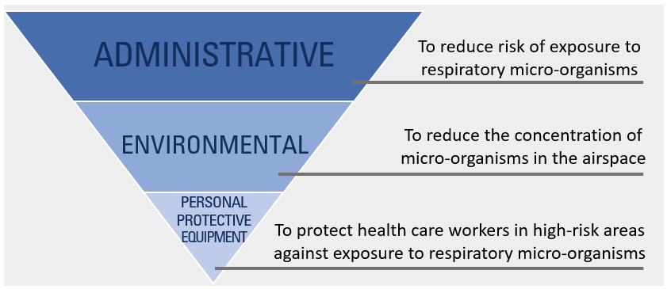
TB infection prevention and control
IPC is a key strategy to prevent further spread of TB bacilli.
Interventions may be implemented at the health facility or community level.
IPC measures include:
Administrative measures
Environmental controls
Use of personal protective equipment (PPE)
Illustration from Basic occupational safety and health for respiratory diseases: a desk guide for health facilities. The Union, 2021
Notes:
In health care settings, particularly those that serves high number of patients with TB, efforts should be made to minimize the risk for TB transmission to other patients and to healthcare workers. Infection control activities may include: administrative measures, environmental controls and/or use of personal protective wear.
Administrative controls are management measures that reduce the risk or exposure to persons with infectious TB. They are the most important measures for infection control and include
Early identification and separation of patients who have presumptive TB (cough triage)
Prompt diagnosis and linkage to treatment
Keeping windows and doors open to allow adequate air circulation
Patient education about respiratory hygiene (including cough etiquette) among people with presumptive or diagnosed TB
Environmental controls are measures that aim to reduce the concentration of TB bacilli in an airspace. Opening windows and door to ensure good cross ventilation is one such measure.
The use of personal protective equipment e.g., use of masks for patients with cough is increasingly practiced in healthcare settings

Slide 25
Conclusion Summary of key points

Slide 26
Conclusion - summary of key points
BCG vaccination protects infants and young children from the most severe forms of TB.
Contact investigation has two main roles:
Active case finding with treatment of disease
Identify contacts who need TPT
Rule out active TB disease before providing TPT.
There is a range of effective and safe TPT regimen options.
Treatment support to completion is critical and improved with community-based or family-based integrated care if feasible.
Infection prevention and control in the household and at the health facility is important to reduce transmission.
ST P TB
Notes:
Let’s review some of the key learning points for this module.
Neonatal BCG vaccination should be routine as it protects infants and young children from the most severe forms of TB
Contact tracing identifies family members/contacts that have already developed disease and those who need TPT
It is important to rule out active TB disease before providing TPT. There is a range of recommended TPT options that are effective and safe – follow national guidelines.
Contacts who <5yr old or are PLHIV are at very high risk for developing TB and so are eligible for TPT without a test
Treatment support to completion is critical, with community-based or family-based integrated care if feasible
Infection control in the household of a TB case or at the health facility level is important to reduce transmission and so prevent TB, This is often forgotten for children and adolescents in those settings.

Slide 27
References
WHO TB Knowledge Sharing Platform: https://www.tbksp.org
BCG vaccines: WHO position paper – February 2018
WHO operational handbook on tuberculosis. Module 5: management of tuberculosis in children and adolescents. World Health Organization, Geneva, 2022
WHO operational handbook on tuberculosis, Module 1: Prevention Tuberculosis preventive treatment. World Health Organization, Geneva, 2024
Desk guide for diagnosis and management of TB in children, The Union, Paris, 2022
Martinez L. et al. The risk of tuberculosis in children after close exposure: a systematic review and individual-participant meta-analysis. Lancet 2020
Martinez L et al. Infant BCG vaccination and risk of pulmonary and extrapulmonary tuberculosis throughout the life course: a systematic review and individual participant data meta-analysis. Lancet Global Health 2022
Martinez L et al. Effectiveness of preventive treatment among different age groups and Mycobacterium tuberculosis infection status: a systematic review and individual-participant data meta-analysis of contact tracing studies. Lancet Resp Med 2024

Slide 28
Challenge your knowledge

Slide 29
Quiz question 1
Which of the following statements regarding the screening for TB among contacts of children and adolescents diagnosed with TB is FALSE?
Is important because it may identify persons with previously undiagnosed TB.
Is best carried out by lay healthcare workers in the home.
Is priorities for contacts of patients diagnosed with bacteriologically confirmed TB and contacts of children diagnosed with TB.
Should be limited to only household contacts as children and adolescents may not have prolonged contact outside the household.

Slide 30
Quiz question 1 - answer
Which of the following statements regarding the screening for TB among contacts of children and adolescents diagnosed with TB is FALSE?
Is important because it may identify persons with previously undiagnosed TB.
Is best carried out by lay healthcare workers in the home.
Is priorities for contacts of patients diagnosed with bacteriologically confirmed TB and contacts of children diagnosed with TB.
Should be limited to only household contacts as children and adolescents may not have prolonged contact outside the household.

Slide 31
Quiz question 2
Which of the following statements regarding ‘TB preventive therapy’ is FALSE?
Is one of several TB preventive strategies that should be implemented in communities with a high TB burden.
Is prioritised for only household and close contacts who test positive for latent TB infection.
Is not recommended for children and adolescents who are contacts of patients diagnosed with multidrug resistant TB.
Shorter treatment regimens for TB preventive therapy tend to have better completion rates than longer treatment regimens.

Slide 32
Quiz question 2 - answer
Which of the following statements regarding ‘TB preventive therapy’ is FALSE?
Is one of several TB preventive strategies that should be implemented in communities with a high TB burden.
Is prioritised for only household and close contacts who test positive for latent TB infection.
Is not recommended for children and adolescents who are contacts of patients diagnosed with multidrug-resistant TB.
Shorter treatment regimens for TB preventive therapy tend to have better completion rates than longer treatment regimens.

